Slide 1
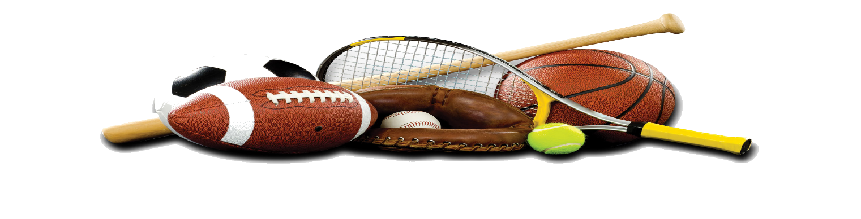

Sports Products Multi-Class Classification
Ahmed Abdo Amin, azad011@uOttawa.ca | Hosam mahmoud ibrahim, hmahm074@uottawa.ca
Abdulrahman Ahmed, aahme275@outtawa.ca | Eslam Abdelraheem Shabaan Khalaf, ekhal066@uottawa.ca
Introduction
Society's interest in sports is expanding, and there are many sports available now that many people are unaware of. Our research will use convolutional neural networks (CNNs) and several deep learning approaches and pre-trend models to perform multi-class classification for 11 different types of sports or their equipment, such as a ball, baseball bat, baseball gloves, bowling bin, dumbbell, boxing gloves, football helmets, racket, sports shoes, t-shirt, and whistle

Slide 2
Sports Products Multi-Class Classification
Ahmed Abdo Amin, azad011@uOttawa.ca | Hosam mahmoud ibrahim, hmahm074@uottawa.ca
Abdulrahman Ahmed, aahme275@outtawa.ca | Eslam Abdelraheem Shabaan Khalaf, ekhal066@uottawa.ca
Introduction
Society's interest in sports is expanding, and there are many sports available now that many people are unaware of. Our research will use convolutional neural networks (CNNs) and several deep learning approaches and pre-trend models to perform multi-class classification for 11 different types of sports or their equipment, such as a ball, baseball bat, baseball gloves, bowling bin, dumbbell, boxing gloves, football helmets, racket, sports shoes, t-shirt, and whistle

Slide 3
Sports Products Multi-Class Classification
Ahmed Abdo Amin, azad011@uOttawa.ca | Hosam mahmoud ibrahim, hmahm074@uottawa.ca
Abdulrahman Ahmed, aahme275@outtawa.ca | Eslam Abdelraheem Shabaan Khalaf, ekhal066@uottawa.ca
Introduction
Society's interest in sports is expanding, and there are many sports available now that many people are unaware of. Our research will use convolutional neural networks (CNNs) and several deep learning approaches and pre-trend models to perform multi-class classification for 11 different types of sports or their equipment, such as a ball, baseball bat, baseball gloves, bowling bin, dumbbell, boxing gloves, football helmets, racket, sports shoes, t-shirt, and whistle
Problem Statement
In previous people used traditional ways to classify products then they used some basic computers software to manage it but in case of using images as products description we need something different to use computer to solve this problem, our thoughts turns quickly to computer vision or machine learning techniques to help us to work with image classification. So, in our project we will work on deep learning project to help us in Sports products multi-class classification problem.

Slide 4
Sports Products Multi-Class Classification
Ahmed Abdo Amin, azad011@uOttawa.ca | Hosam mahmoud ibrahim, hmahm074@uottawa.ca
Abdulrahman Ahmed, aahme275@outtawa.ca | Eslam Abdelraheem Shabaan Khalaf, ekhal066@uottawa.ca
Introduction
Society's interest in sports is expanding, and there are many sports available now that many people are unaware of. Our research will use convolutional neural networks (CNNs) and several deep learning approaches and pre-trend models to perform multi-class classification for 11 different types of sports or their equipment, such as a ball, baseball bat, baseball gloves, bowling bin, dumbbell, boxing gloves, football helmets, racket, sports shoes, t-shirt, and whistle
Problem Statement
In previous people used traditional ways to classify products then they used some basic computers software to manage it but in case of using images as products description we need something different to use computer to solve this problem, our thoughts turns quickly to computer vision or machine learning techniques to help us to work with image classification. So, in our project we will work on deep learning project to help us in Sports products multi-class classification problem.

Slide 5
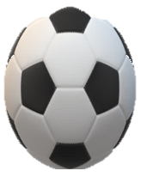
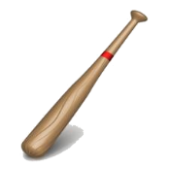
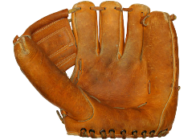
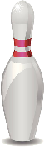
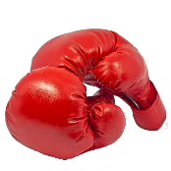
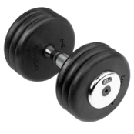
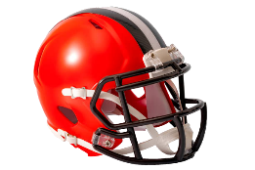
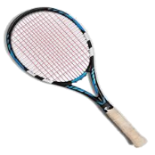
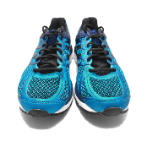
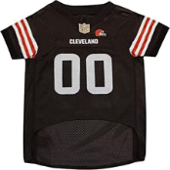
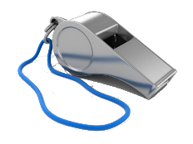
Sports Products Multi-Class Classification
Ahmed Abdo Amin, azad011@uOttawa.ca | Hosam mahmoud ibrahim, hmahm074@uottawa.ca
Abdulrahman Ahmed, aahme275@outtawa.ca | Eslam Abdelraheem Shabaan Khalaf, ekhal066@uottawa.ca
Introduction
Society's interest in sports is expanding, and there are many sports available now that many people are unaware of. Our research will use convolutional neural networks (CNNs) and several deep learning approaches and pre-trend models to perform multi-class classification for 11 different types of sports or their equipment, such as a ball, baseball bat, baseball gloves, bowling bin, dumbbell, boxing gloves, football helmets, racket, sports shoes, t-shirt, and whistle
Datasets
How to collect the data set:
First, use an online website to collect images of sports tools.
Second, segment the downloaded images into 11 classes.
Problem Statement
Ball
Baseball bat
Baseball Gloves
Bowling bin
In previous people used traditional ways to classify products then they used some basic computers software to manage it but in case of using images as products description we need something different to use computer to solve this problem, our thoughts turns quickly to computer vision or machine learning techniques to help us to work with image classification. So, in our project we will work on deep learning project to help us in Sports products multi-class classification problem.
Boxing Gloves
Dumb bell
Football Helmets
Racket
Sport Shoes
T-shirt
Whistle
Finally, 11 classes were split into training, validation, and testing data sets of 440, 55, and 55 images, respectively.

Slide 6
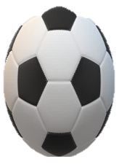
Sports Products Multi-Class Classification
Ahmed Abdo Amin, azad011@uOttawa.ca | Hosam mahmoud ibrahim, hmahm074@uottawa.ca
Abdulrahman Ahmed, aahme275@outtawa.ca | Eslam Abdelraheem Shabaan Khalaf, ekhal066@uottawa.ca
Introduction
Datasets
Society's interest in sports is expanding, and there are many sports available now that many people are unaware of. Our research will use convolutional neural networks (CNNs) and several deep learning approaches and pre-trend models to perform multi-class classification for 11 different types of sports or their equipment, such as a ball, baseball bat, baseball gloves, bowling bin, dumbbell, boxing gloves, football helmets, racket, sports shoes, t-shirt, and whistle
How to collect the data set:
First, use an online website to collect images of sports tools.
Second, segment the downloaded images into 11 classes.
Ball
Baseball bat
Baseball Gloves
Bowling bin
Problem Statement
In previous people used traditional ways to classify products then they used some basic computers software to manage it but in case of using images as products description we need something different to use computer to solve this problem, our thoughts turns quickly to computer vision or machine learning techniques to help us to work with image classification. So, in our project we will work on deep learning project to help us in Sports products multi-class classification problem.
Boxing Gloves
Dumb bell
Football Helmets
Racket
Sport Shoes
T-shirt
Whistle
Finally, 11 classes were split into training, validation, and testing data sets of 440, 55, and 55 images, respectively.

Slide 7
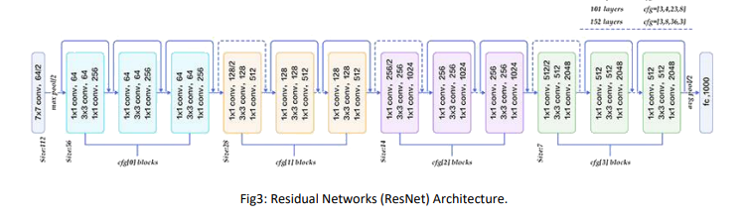
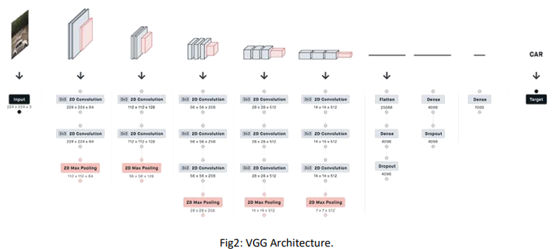
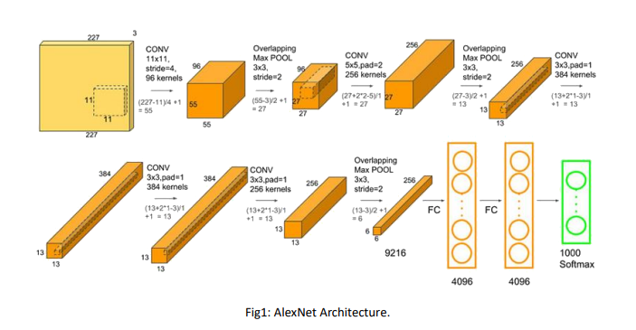
Sports Products Multi-Class Classification
Ahmed Abdo Amin, azad011@uOttawa.ca | Hosam mahmoud ibrahim, hmahm074@uottawa.ca
Abdulrahman Ahmed, aahme275@outtawa.ca | Eslam Abdelraheem Shabaan Khalaf, ekhal066@uottawa.ca
Introduction
Datasets
Society's interest in sports is expanding, and there are many sports available now that many people are unaware of. Our research will use convolutional neural networks (CNNs) and several deep learning approaches and pre-trend models to perform multi-class classification for 11 different types of sports or their equipment, such as a ball, baseball bat, baseball gloves, bowling bin, dumbbell, boxing gloves, football helmets, racket, sports shoes, t-shirt, and whistle
Methods
How to collect the data set:
First, use an online website to collect images of sports tools.
Second, segment the downloaded images into 11 classes.
First Model (ResNet):
Ball
Baseball bat
Baseball Gloves
Bowling bin
Boxing Gloves
Dumb bell
Second Model (VGGModel):
Problem Statement
Football Helmets
Racket
In previous people used traditional ways to classify products then they used some basic computers software to manage it but in case of using images as products description we need something different to use computer to solve this problem, our thoughts turns quickly to computer vision or machine learning techniques to help us to work with image classification. So, in our project we will work on deep learning project to help us in Sports products multi-class classification problem.
Sport Shoes
T-shirt
Whistle
Finally, 11 classes were split into training, validation, and testing data sets of 440, 55, and 55 images, respectively.
Third Model (AlexNet):

Slide 8
Sports Products Multi-Class Classification
Ahmed Abdo Amin, azad011@uOttawa.ca | Hosam mahmoud ibrahim, hmahm074@uottawa.ca
Abdulrahman Ahmed, aahme275@outtawa.ca | Eslam Abdelraheem Shabaan Khalaf, ekhal066@uottawa.ca
Introduction
Datasets
Methods
Society's interest in sports is expanding, and there are many sports available now that many people are unaware of. Our research will use convolutional neural networks (CNNs) and several deep learning approaches and pre-trend models to perform multi-class classification for 11 different types of sports or their equipment, such as a ball, baseball bat, baseball gloves, bowling bin, dumbbell, boxing gloves, football helmets, racket, sports shoes, t-shirt, and whistle
First Model (ResNet):
How to collect the data set:
First, use an online website to collect images of sports tools.
Second, segment the downloaded images into 11 classes.
Second Model (VGGModel):
Ball
Baseball bat
Baseball Gloves
Bowling bin
Problem Statement
In previous people used traditional ways to classify products then they used some basic computers software to manage it but in case of using images as products description we need something different to use computer to solve this problem, our thoughts turns quickly to computer vision or machine learning techniques to help us to work with image classification. So, in our project we will work on deep learning project to help us in Sports products multi-class classification problem.
Boxing Gloves
Dumb bell
Football Helmets
Racket
Third Model (AlexNet):
Sport Shoes
T-shirt
Whistle
Finally, 11 classes were split into training, validation, and testing data sets of 440, 55, and 55 images, respectively.

Slide 9
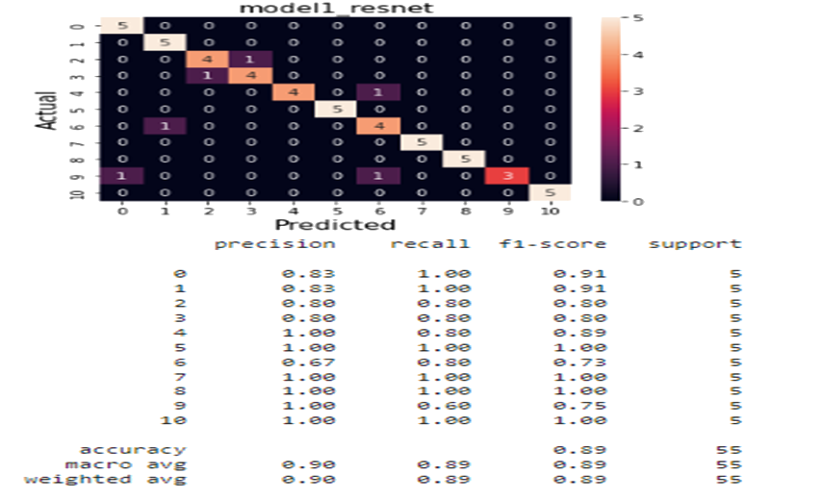
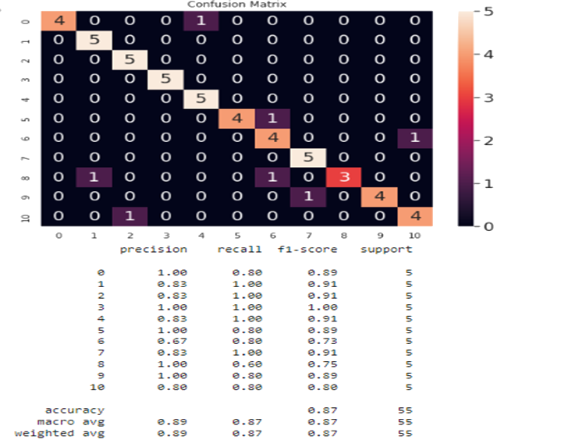
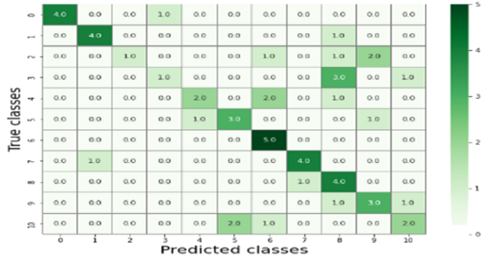
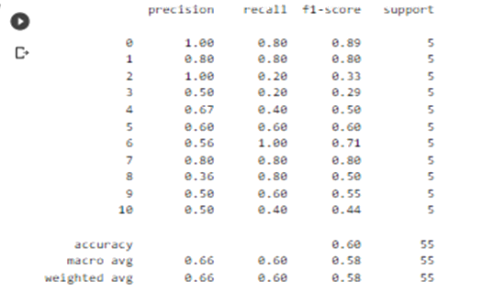
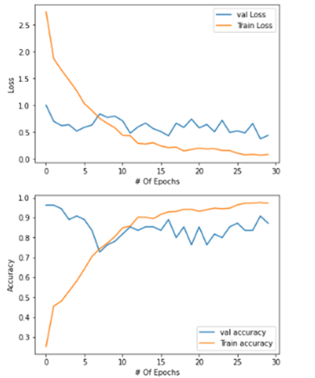
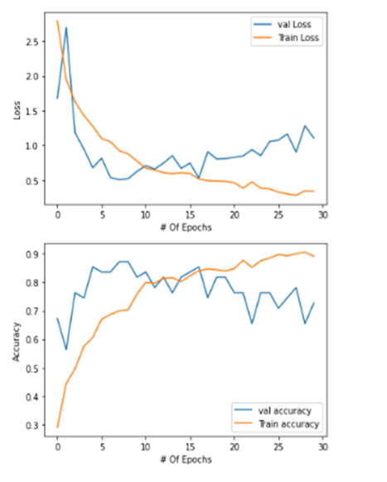
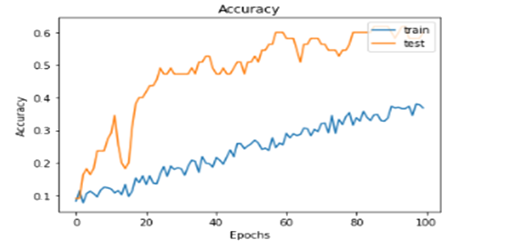
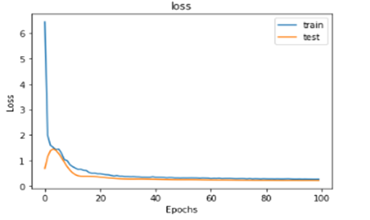
Sports Products Multi-Class Classification
Ahmed Abdo Amin, azad011@uOttawa.ca | Hosam mahmoud ibrahim, hmahm074@uottawa.ca
Abdulrahman Ahmed, aahme275@outtawa.ca | Eslam Abdelraheem Shabaan Khalaf, ekhal066@uottawa.ca
Introduction
Datasets
Methods
Evaluation
Society's interest in sports is expanding, and there are many sports available now that many people are unaware of. Our research will use convolutional neural networks (CNNs) and several deep learning approaches and pre-trend models to perform multi-class classification for 11 different types of sports or their equipment, such as a ball, baseball bat, baseball gloves, bowling bin, dumbbell, boxing gloves, football helmets, racket, sports shoes, t-shirt, and whistle
First Model (ResNet):
First Model (ResNet):
Third Model (AlexNet):
How to collect the data set:
First, use an online website to collect images of sports tools.
Second, segment the downloaded images into 11 classes.
Second Model (VGGModel):
Second Model (VGGModel):
Ball
Baseball bat
Baseball Gloves
Bowling bin
Problem Statement
Boxing Gloves
Dumb bell
Football Helmets
Racket
In previous people used traditional ways to classify products then they used some basic computers software to manage it but in case of using images as products description we need something different to use computer to solve this problem, our thoughts turns quickly to computer vision or machine learning techniques to help us to work with image classification. So, in our project we will work on deep learning project to help us in Sports products multi-class classification problem.
Third Model (AlexNet):
Sport Shoes
T-shirt
Whistle
Finally, 11 classes were split into training, validation, and testing data sets of 440, 55, and 55 images, respectively.

Slide 10
Sports Products Multi-Class Classification
Ahmed Abdo Amin, azad011@uOttawa.ca | Hosam mahmoud ibrahim, hmahm074@uottawa.ca
Abdulrahman Ahmed, aahme275@outtawa.ca | Eslam Abdelraheem Shabaan Khalaf, ekhal066@uottawa.ca
Evaluation
Introduction
Datasets
Methods
First Model (ResNet):
Society's interest in sports is expanding, and there are many sports available now that many people are unaware of. Our research will use convolutional neural networks (CNNs) and several deep learning approaches and pre-trend models to perform multi-class classification for 11 different types of sports or their equipment, such as a ball, baseball bat, baseball gloves, bowling bin, dumbbell, boxing gloves, football helmets, racket, sports shoes, t-shirt, and whistle
First Model (ResNet):
How to collect the data set:
First, use an online website to collect images of sports tools.
Second, segment the downloaded images into 11 classes.
Second Model (VGGModel):
Second Model (VGGModel):
Ball
Baseball bat
Baseball Gloves
Bowling bin
Problem Statement
In previous people used traditional ways to classify products then they used some basic computers software to manage it but in case of using images as products description we need something different to use computer to solve this problem, our thoughts turns quickly to computer vision or machine learning techniques to help us to work with image classification. So, in our project we will work on deep learning project to help us in Sports products multi-class classification problem.
Boxing Gloves
Dumb bell
Football Helmets
Racket
Third Model (AlexNet):
Third Model (AlexNet):
Sport Shoes
T-shirt
Whistle
Finally, 11 classes were split into training, validation, and testing data sets of 440, 55, and 55 images, respectively.

Slide 11
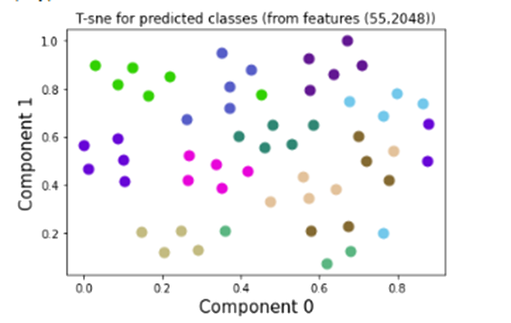
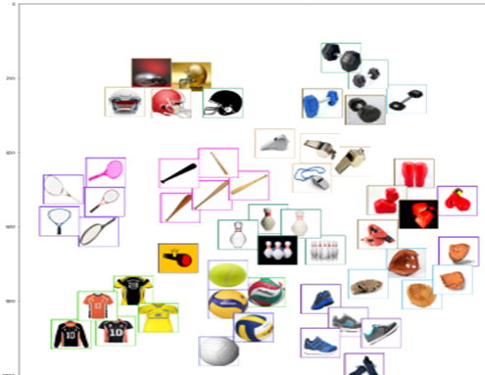
Sports Products Multi-Class Classification
Ahmed Abdo Amin, azad011@uOttawa.ca | Hosam mahmoud ibrahim, hmahm074@uottawa.ca
Evaluation
Abdulrahman Ahmed, aahme275@outtawa.ca | Eslam Abdelraheem Shabaan Khalaf, ekhal066@uottawa.ca
First Model (ResNet):
Introduction
Datasets
Methods
Society's interest in sports is expanding, and there are many sports available now that many people are unaware of. Our research will use convolutional neural networks (CNNs) and several deep learning approaches and pre-trend models to perform multi-class classification for 11 different types of sports or their equipment, such as a ball, baseball bat, baseball gloves, bowling bin, dumbbell, boxing gloves, football helmets, racket, sports shoes, t-shirt, and whistle
First Model (ResNet):
How to collect the data set:
First, use an online website to collect images of sports tools.
Second, segment the downloaded images into 11 classes.
Conclusion
Second Model (VGGModel):
The champion model ResNet 152 with fine tuning
Second Model (VGGModel):
Ball
Baseball bat
Baseball Gloves
Bowling bin
Problem Statement
In previous people used traditional ways to classify products then they used some basic computers software to manage it but in case of using images as products description we need something different to use computer to solve this problem, our thoughts turns quickly to computer vision or machine learning techniques to help us to work with image classification. So, in our project we will work on deep learning project to help us in Sports products multi-class classification problem.
Boxing Gloves
Dumb bell
Football Helmets
Racket
Third Model (AlexNet):
Third Model (AlexNet):
Sport Shoes
T-shirt
Whistle
Finally, 11 classes were split into training, validation, and testing data sets of 440, 55, and 55 images, respectively.

Slide 12
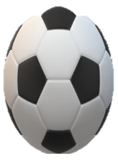
Sports Products Multi-Class Classification
Ahmed Abdo Amin, azad011@uOttawa.ca | Hosam mahmoud ibrahim, hmahm074@uottawa.ca
Abdulrahman Ahmed, aahme275@outtawa.ca | Eslam Abdelraheem Shabaan Khalaf, ekhal066@uottawa.ca
Evaluation
Introduction
Datasets
Methods
First Model (ResNet):
Society's interest in sports is expanding, and there are many sports available now that many people are unaware of. Our research will use convolutional neural networks (CNNs) and several deep learning approaches and pre-trend models to perform multi-class classification for 11 different types of sports or their equipment, such as a ball, baseball bat, baseball gloves, bowling bin, dumbbell, boxing gloves, football helmets, racket, sports shoes, t-shirt, and whistle
First Model (ResNet):
How to collect the data set:
First, use an online website to collect images of sports tools.
Second, segment the downloaded images into 11 classes.
Second Model (VGGModel):
Second Model (VGGModel):
Ball
Baseball bat
Baseball Gloves
Bowling bin
Problem Statement
In previous people used traditional ways to classify products then they used some basic computers software to manage it but in case of using images as products description we need something different to use computer to solve this problem, our thoughts turns quickly to computer vision or machine learning techniques to help us to work with image classification. So, in our project we will work on deep learning project to help us in Sports products multi-class classification problem.
Boxing Gloves
Dumb bell
Football Helmets
Racket
Third Model (AlexNet):
Third Model (AlexNet):
Sport Shoes
T-shirt
Whistle
Finally, 11 classes were split into training, validation, and testing data sets of 440, 55, and 55 images, respectively.
Conclusion
The champion model ResNet 152 with fine tuning

Slide 13

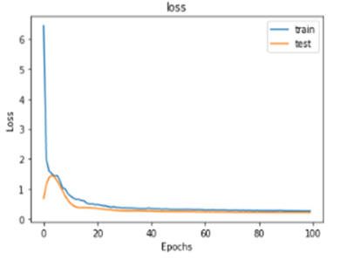
Sports Products Multi-Class Classification
Ahmed Abdo Amin, azad011@uOttawa.ca | Hosam mahmoud ibrahim, hmahm074@uottawa.ca
Abdulrahman Ahmed, aahme275@outtawa.ca | Eslam Abdelraheem Shabaan Khalaf, ekhal066@uottawa.ca
Evaluation
Deployment
Introduction
Datasets
Methods
First Model (ResNet):
Solution Design:-
First Model (ResNet):
A computer is a critical life need like food and water and we cannot imagine our life without the computer because our all knowledge, activities, works, memories, history, and lifestyles are managed and stored by the computer, in the work area it facilitates and manage many tasks very fast and in an organized way.
How to collect the data set:
First, use an online website to collect images of sports tools.
Second, segment the downloaded images into 11 classes.
- Using HTML , CSS and JavaScript for the design.
- Using a flask library to connect our model with the user interface.
This video depicts the website that displays the champion model's results
Second Model (VGGModel):
Second Model (VGGModel):
Ball
Baseball bat
Baseball Gloves
Bowling bin
Problem Statement
In previous people used papers to classify products then they used some basic computers software to manage it but in case of using images as products description we need something different to use computer to solve this problem, our thoughts turns quickly to computer vision or machine learning techniques to help us to work with image classification. So, in our project we will work on deep learning project to help us in Sports products multi-class classification problem.
Boxing Gloves
Dumb bell
Football Helmets
Racket
Third Model (AlexNet):
Third Model (AlexNet):
Sport Shoes
T-shirt
Whistle
Finally, 11 classes were split into training, validation, and testing data sets of 440, 55, and 55 images, respectively.
Conclusion
The champion model ResNet 152 with fine tuning

Slide 14
Sports Products Multi-Class Classification
Ahmed Abdo Amin, azad011@uOttawa.ca | Hosam mahmoud ibrahim, hmahm074@uottawa.ca
Abdulrahman Ahmed, aahme275@outtawa.ca | Eslam Abdelraheem Shabaan Khalaf, ekhal066@uottawa.ca
Evaluation
Introduction
Datasets
Methods
First Model (ResNet):
Society's interest in sports is expanding, and there are many sports available now that many people are unaware of. Our research will use convolutional neural networks (CNNs) and several deep learning approaches and pre-trend models to perform multi-class classification for 11 different types of sports or their equipment, such as a ball, baseball bat, baseball gloves, bowling bin, dumbbell, boxing gloves, football helmets, racket, sports shoes, t-shirt, and whistle
First Model (ResNet):
How to collect the data set:
First, use an online website to collect images of sports tools.
Second, segment the downloaded images into 11 classes.
Second Model (VGGModel):
Second Model (VGGModel):
Ball
Baseball bat
Baseball Gloves
Bowling bin
Problem Statement
Boxing Gloves
Dumb bell
Football Helmets
Racket
In previous people used traditional ways to classify products then they used some basic computers software to manage it but in case of using images as products description we need something different to use computer to solve this problem, our thoughts turns quickly to computer vision or machine learning techniques to help us to work with image classification. So, in our project we will work on deep learning project to help us in Sports products multi-class classification problem.
Third Model (AlexNet):
Third Model (AlexNet):
Sport Shoes
T-shirt
Whistle
Finally, 11 classes were split into training, validation, and testing data sets of 440, 55, and 55 images, respectively.
Conclusion
Deployment
Solution Design:-
This video depicts the website that displays the champion model's results
The champion model ResNet 152 with fine tuning
- Using HTML , CSS and JavaScript for the design.
- Using a flask library to connect our model with the user interface.

